Slide 1
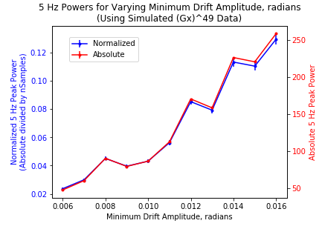
Varying the amplitude of a single 5 Hz drift oscillation

Slide 2
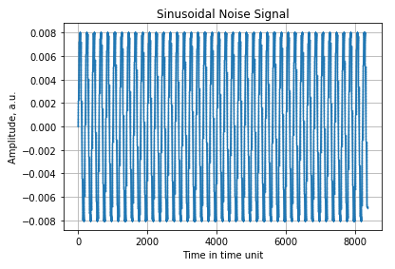
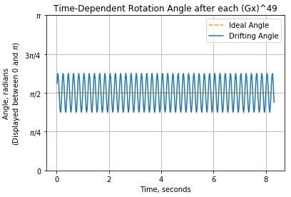
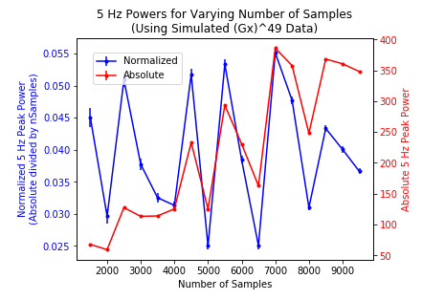
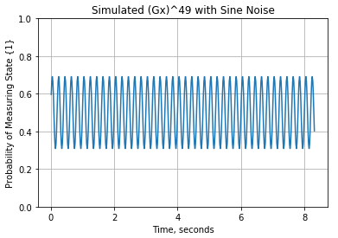
Varying the number of samples for a 5 Hz, 0.008 amplitude oscillation with Gx49

Slide 3
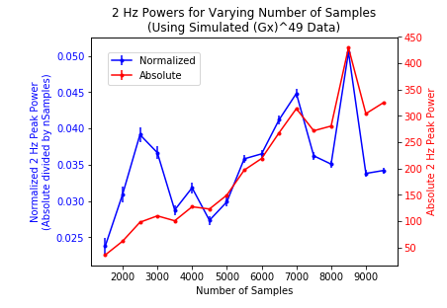
Same settings, except I changed the frequency to 2 Hz.
It still seems to center around 0.04 at longer samples…This may be because 2 Hz takes longer to appear in time.
I want to try plots like these but with more trials per set of parameters. Are these wide fluctuations in normalized power just statistical and do they averaged out to something meaningful?

Slide 4
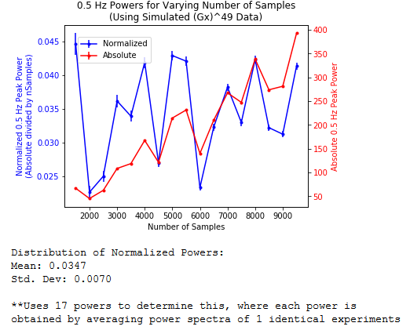
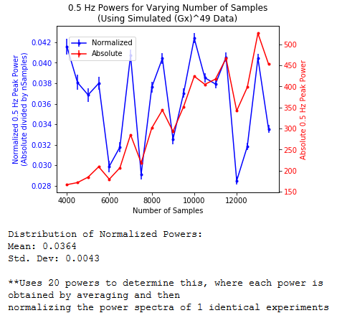
Lowered down to 0.5 Hz. The normalized power again seems to stabilize some more a longer sample numbers.

Slide 5
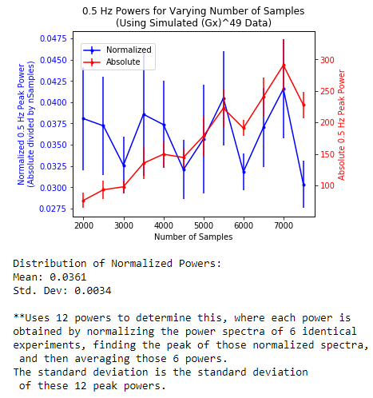
Instead of just using one trial per parameter set and using the normalized spectrum from each, I used 6 trials per parameter set, over 12 parameter values, and looked at the average normalized peak power across the 6 trials.
There seems to be a pretty steady 0.036 or .037-ish value.
Just to check, let’s go back and try some different frequencies, but keep the amplitude the same.

Slide 6
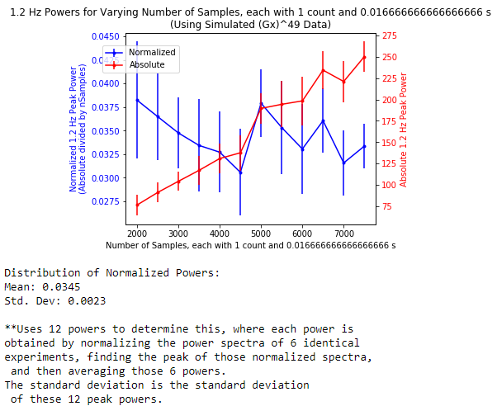
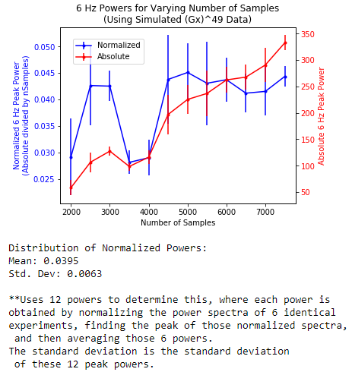

Slide 7
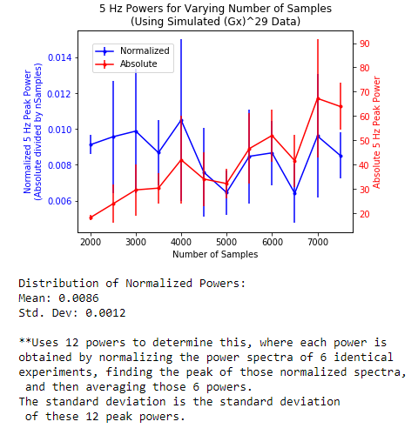
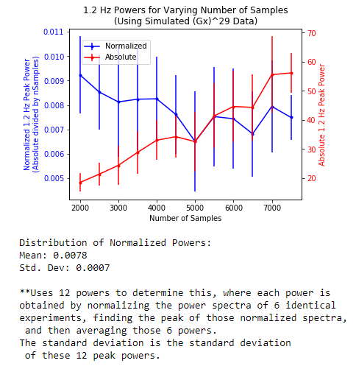
Now try Gx29 with 5 Hz, and 0.006 amplitude
Now try Gx29 with 1.2 Hz, and 0.006 amplitude

Slide 8
Freq | Applied Amplitude | Gx | Peak-to-Trough amplitude of |1> state probability (after all Gx gates) | Avg. Normalized Power (from various sample sizes) | Std. Dev
5 | 0.006 | 29 | 0.17 | 0.0086 | 0.0012
1.2 | 0.006 | 29 | 0.17 | 0.0078 | 0.0007
1.2 | 0.008 | 49 | 0.38 | 0.0345 | 0.0023
6 | 0.008 | 49 | 0.38 | 0.0395 | 0.0063
0.5 | 0.008 | 49 | 0.38 | 0.0361 | 0.0034
1.2 | 0.008 | 29 | 0.22 | 0.0131 | 0.0011
3 | 0.010 | 29 | 0.29 | 0.0199 | 0.0018
3 | 0.010 | 79 | 0.71 | 0.1236 | 0.0077
How do we get back the applied amplitude if we know Gx and the normalized power?

Slide 9
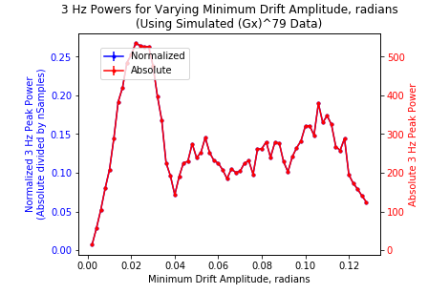
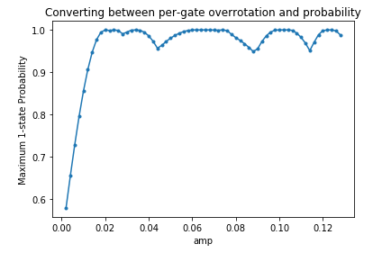
Interestingly, once we start overrotating so much that an rotation intended to increase the 1-state probability actually decreases it (overrotation past pi), there is no longer a clear relationship between the normalized peak power and angle drift amplitude/max probability

Slide 10
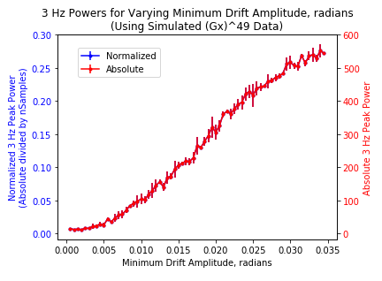
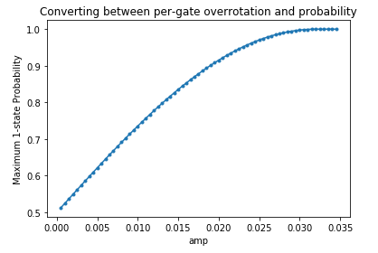
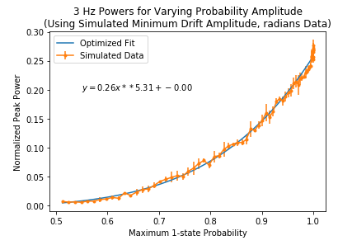
Let’s try instead seeing the relationship between maximum normalized power and drift amplitude/maximum probability for lower drift amplitudes
This means applying fewer Gx gates and/or decreasing the oscillation amplitude, S.T. the 1-state probability never rotates past 1
This data all uses 2000 samples of Gx49.
Each plotted power is an average of 4 experiments.

Slide 11
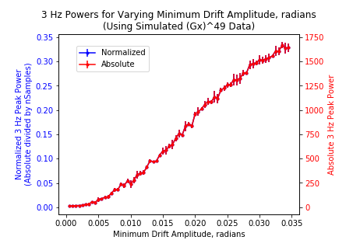
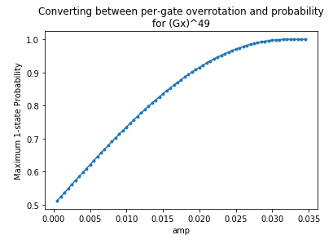
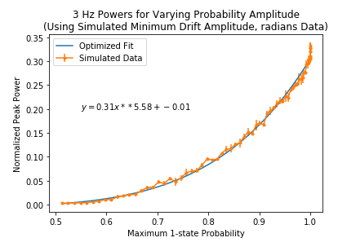
Using Gx49 with 5000 samples, we get a similar relationship between 1-state probability and peak power

Slide 12
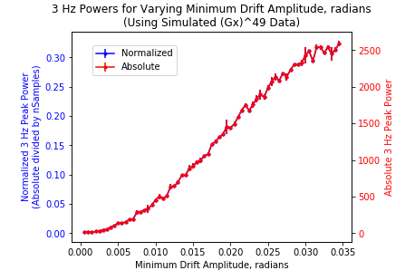
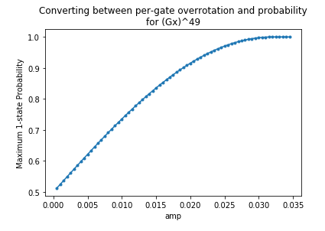
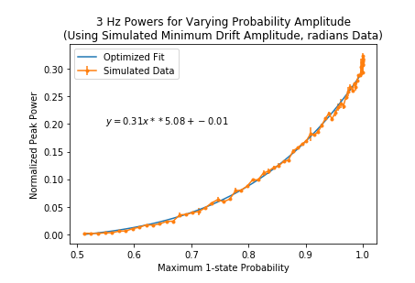
With 8000 samples (though only averaged only 2 trials each for speed purposes)

Slide 13
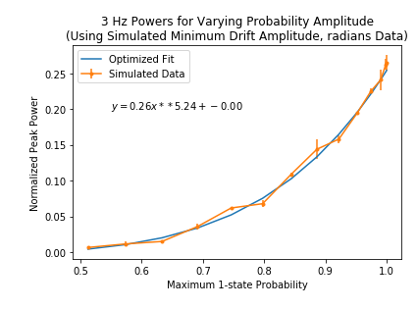
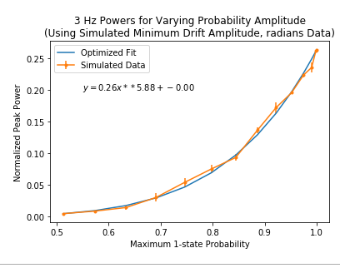
Let’s go back down to 2000x Gx49, but for 3 Hz with 0.005 amp. This should yield a smaller peak, but let’s see if the relationship still holds.
I also used a larger step size for the amplitudes
Looks like the front coefficient dropped a bit. Keep 2000x Gx49, but start with 0.009 amp. Keep the same amount of steps and step sizes in amplitude increase.

Slide 14
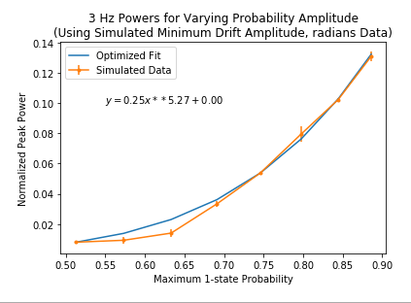
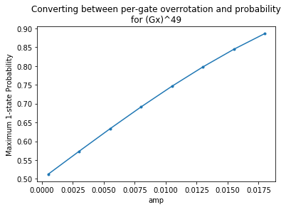
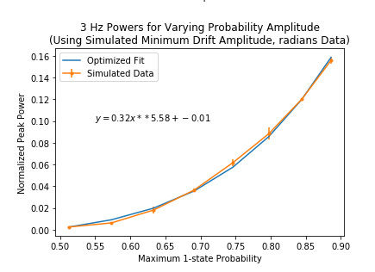
Using fewer increases in amplitude didn’t take us all the way up to p = 1, so we got a different fit than usual.
However, even with smaller amplitudes, using 7000 data points increased the first coefficient.

Slide 15
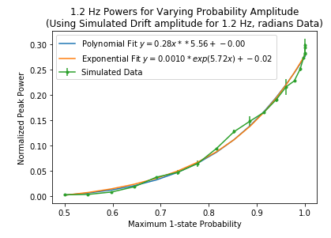
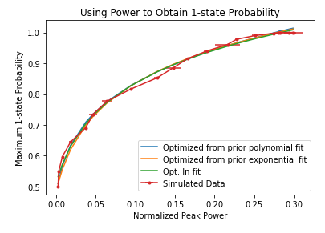
Just rewriting the optimized fit as a function of x(y), you can obtain the prob. Vs. power function on the right. The question is: why does it follow that structure, and how do we arrive at those constants?

